Slide 1
Evaluating High-Voltage Battery Performance in the BMW i3 (60 Ah)
Group 8
2024/12/17

Slide 2
Project Overview
Objective: Predict battery performance of electric vehicles
Data: Information on 72 driving trips of a BMW i3
Outcome: Battery consumption (difference between the start and end battery levels)
Features:
Environment: weather, route, area
Vehicle: distance, speed, battery temperature, cabin temperature
Questions
Which models predict battery consumption better: Linear Models or Tree-Based Models?
Which features are more important for predicting battery usage: Environment or Vehicle?
Approach
Test/training data split
Models: Linear Models and Tree-Based Models

Slide 3
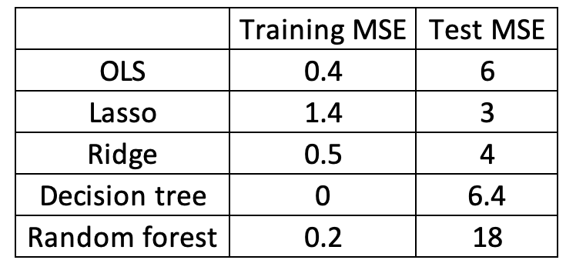
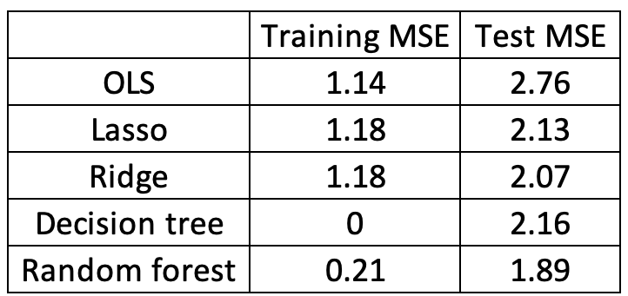
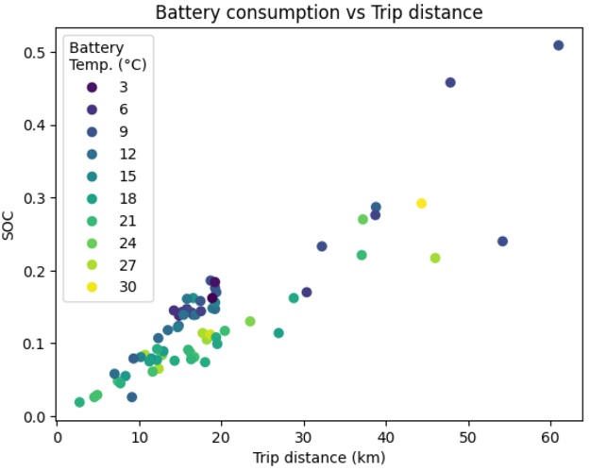
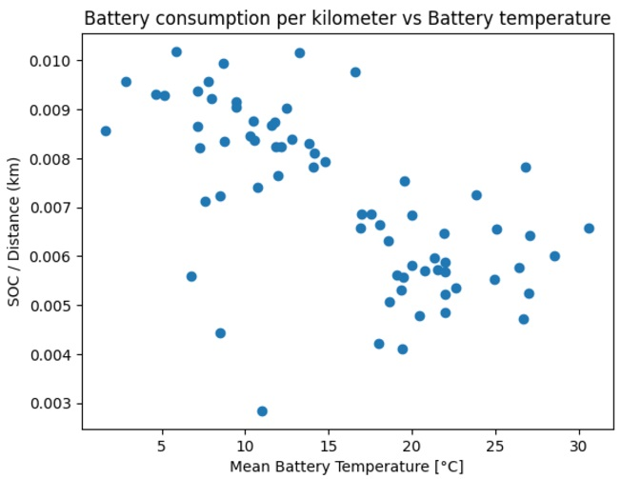
Model Performance Summary
Outcome variable: Battery consumption
MSE
Feature importance: Distance (>0.90), battery/ambient temperature (~0.05), others (< 0.01)
Outcome variable: Battery consumption / distance
Graph the results

Slide 4
Discussions
Implications
Tree models perform worse for linear relationships but better for non-linear relationships compared to linear models
Temperature (and distance) is the most important feature in predicting battery usage
Limitations
Small sample size
Cannot use cross-validation for model selection
Lack of other important features
Acceleration, brake usage, etc.
Further research
Granular data is needed to analyze time series effectively

Slide 5
Acknowledgment of Team Members - Group 8
Daniel I Lin
UID: 121033345
Email: dlin0315@umd.edu
Hao-Lin Chiang
UID: 121166357
Email: beas28@umd.edu
Yang-Shun Lin
UID: 121287762
Email: yslin227@umd.edu
Sheng-Hsiang Huang
UID: 121303554
Email: shhuang@umd.edu
Alexios C Papazoglou
UID: 121332967
Email: apapazog@umd.edu
Kai-Wei Hsu
UID: 121366191
Email: kwhsu@umd.edu
Thank you for your attention!
Group 8 - University of Maryland

